Slide 1


Day 24
Math24 (Differential Equations)
Ch 6.2 Solution of Initial Value Problems (Page 317-327)
Elementary Differential Equations and Boundary Value Problems, 10th edition, by William E. Boyce and Richard C. DiPrima, ©2013 by John Wiley & Sons, Inc.

Slide 2
The Laplace transform is named for the French mathematician Laplace, who studied this transform in 1782.
The techniques described in this chapter were developed primarily by Oliver Heaviside (1850-1925), an English electrical engineer.
In this section we see how the Laplace transform can be used to solve initial value problems for linear differential equations with constant coefficients.
The Laplace transform is useful in solving these differential equations because the transform of f ' is related in a simple way to the transform of f, as stated in Theorem 6.2.1.

Slide 3

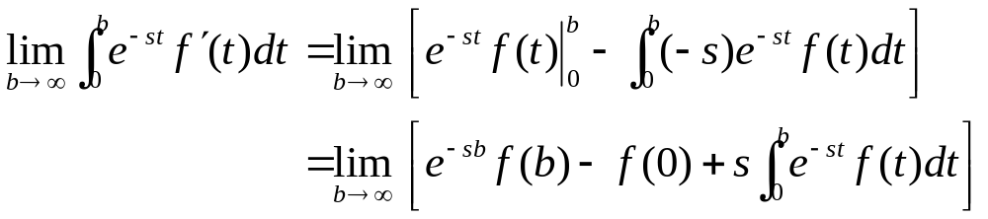
Theorem 6.2.1
Suppose that f is a function for which the following hold:
  (1) f is continuous and f ' is piecewise continuous on [0, b] for all b > 0.
  (2) | f(t) | ≤ Ke^{at} when t ≥ M, for constants a, K, M, with K, M > 0.
Then the Laplace Transform of f ' exists for s > a, with
Proof (outline): For f and f ' continuous on [0, b], we have
Similarly for f ' piecewise continuous on [0, b], see text.

Slide 4

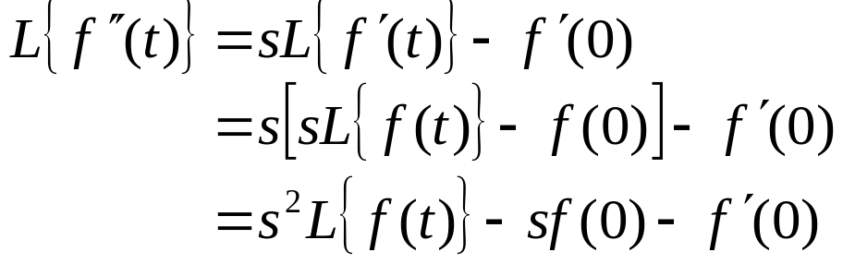
The Laplace Transform of f '
Thus if f and f ' satisfy the hypotheses of Theorem 6.2.1, then
Now suppose f ' and f '' satisfy the conditions specified for f and f ' of Theorem 6.2.1. We then obtain
Similarly, we can derive an expression for L{f ^{(n)}}, provided f and its derivatives satisfy suitable conditions. This result is given in Corollary 6.2.2

Slide 5
Corollary 6.2.2
Suppose that f is a function for which the following hold:
  (1) f , f ', f '' ,…, f ^{(n-1)} are continuous, and f ^{(n)} piecewise continuous, on [0, b] for all b > 0.
  (2) | f(t) | ≤ Ke^{at}, | f '(t) | ≤ Ke^{at} , …, | f ^{(n-1)}(t) | ≤ Ke^{at} for t ≥ M, for constants a, K, M, with K, M > 0.
Then the Laplace Transform of f ^{(n)} exists for s > a, with

Slide 6

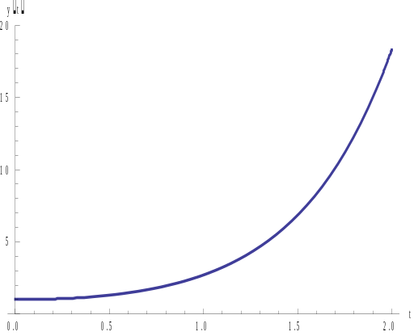

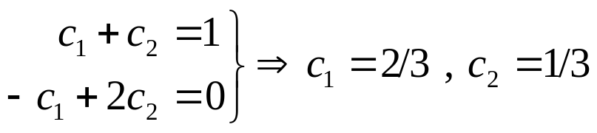

Example 1: Chapter 3 Method (1 of 4)
Consider the initial value problem
Recall from Section 3.1:
Thus r₁ = -2 and r₂ = -3, and general solution has the form
Using initial conditions:
Thus
We now solve this problem using Laplace Transforms.

Slide 7

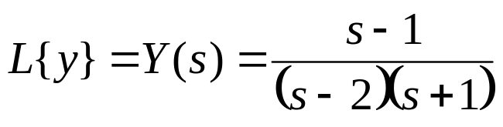
Example 1: Laplace Transform Method (2 of 4)
Assume that our IVP has a solution φ and that φ'(t) and φ''(t) satisfy the conditions of Corollary 6.2.2. Then
and hence
Letting Y(s) = L{y}, we have
Substituting in the initial conditions, we obtain
Thus

Slide 8
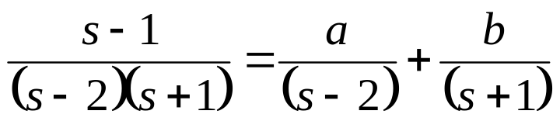
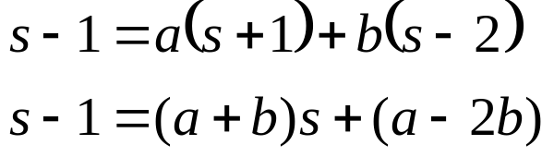
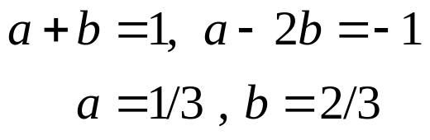
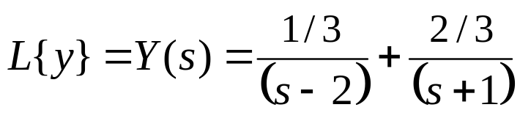
Example 1: Partial Fractions (3 of 4)
Using partial fraction decomposition, Y(s) can be rewritten:
Thus

Slide 9
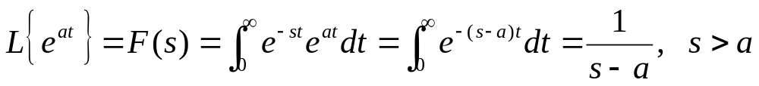
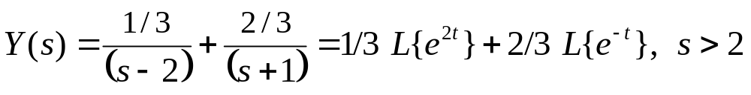

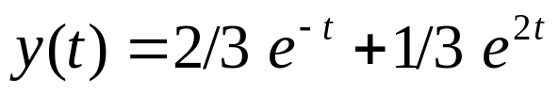
Example 1: Solution (4 of 4)
Recall from Section 6.1:
Thus
Recalling Y(s) = L{y}, we have
and hence

Slide 10

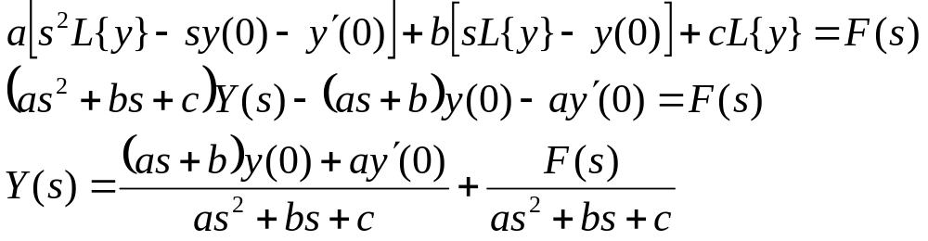
General Laplace Transform Method
Consider the constant coefficient equation
Assume that this equation has a solution y = φ(t), and that φ'(t) and φ''(t) satisfy the conditions of Corollary 6.2.2. Then
If we let Y(s) = L{y} and F(s) = L{ f }, then

Slide 11
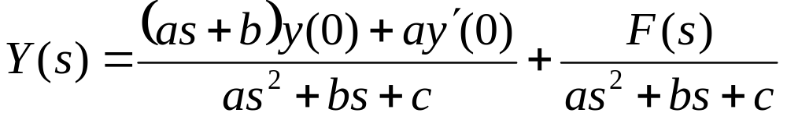
Algebraic Problem
Thus the differential equation has been transformed into the the algebraic equation
for which we seek y = φ(t) such that L{φ(t)} = Y(s).
Note that we do not need to solve the homogeneous and nonhomogeneous equations separately, nor do we have a separate step for using the initial conditions to determine the values of the coefficients in the general solution.

Slide 12
Characteristic Polynomial
Using the Laplace transform, our initial value problem
becomes
The polynomial in the denominator is the characteristic polynomial associated with the differential equation.
The partial fraction expansion of Y(s) used to determine φ requires us to find the roots of the characteristic equation.
For higher order equations, this may be difficult, especially if the roots are irrational or complex.

Slide 13
Inverse Problem
The main difficulty in using the Laplace transform method is determining the function y = φ(t) such that L{φ(t)} = Y(s).
This is an inverse problem, in which we try to find φ such that φ(t) = L⁻¹{Y(s)}.
There is a general formula for L⁻¹, but it requires knowledge of the theory of functions of a complex variable, and we do not consider it here.
It can be shown that if f is continuous with L{f(t)} = F(s), then f is the unique continuous function with f (t) = L⁻¹{F(s)}.
Table 6.2.1 in the text lists many of the functions and their transforms that are encountered in this chapter.

Slide 14



Linearity of the Inverse Transform
Frequently a Laplace transform F(s) can be expressed as
Let
Then the function
has the Laplace transform F(s), since L is linear.
By the uniqueness result of the previous slide, no other continuous function f has the same transform F(s).
Thus L⁻¹ is a linear operator with

Slide 15

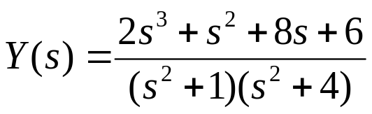
Example 2: Nonhomogeneous Problem (1 of 2)
Consider the initial value problem
Taking the Laplace transform of the differential equation, and assuming the conditions of Corollary 6.2.2 are met, we have
Letting Y(s) = L{y}, we have
Substituting in the initial conditions, we obtain
Thus

Slide 16
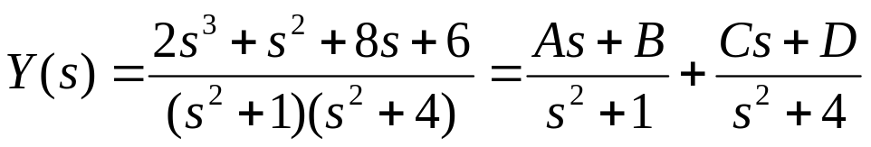
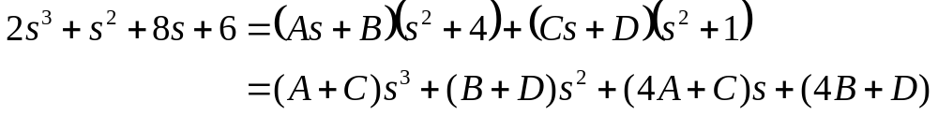
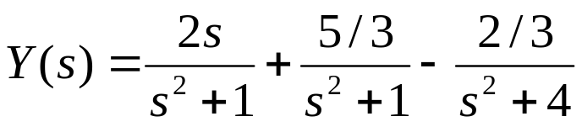
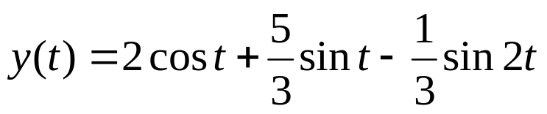
Example 2: Solution (2 of 2)
Using partial fractions,
Then
Solving, we obtain A = 2, B = 5/3, C = 0, and D = -2/3. Thus
Hence

Slide 17
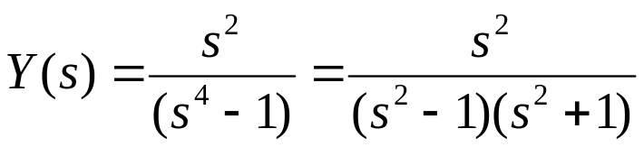
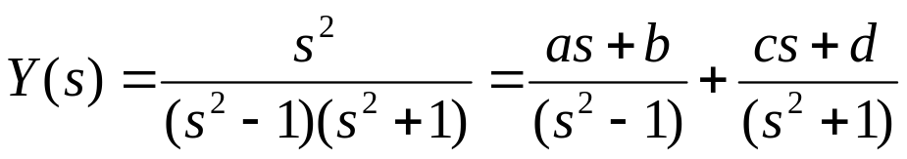

Example 3: Solving a 4th Order IVP (1 of 2)
Consider the initial value problem
Taking the Laplace transform of the differential equation, and assuming the conditions of Corollary 6.2.2 are met, we have
Letting Y(s) = L{y} and substituting the initial values, we have
Using partial fractions
Thus

Slide 18

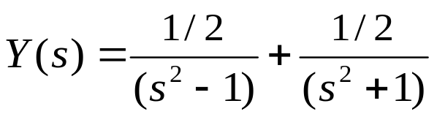
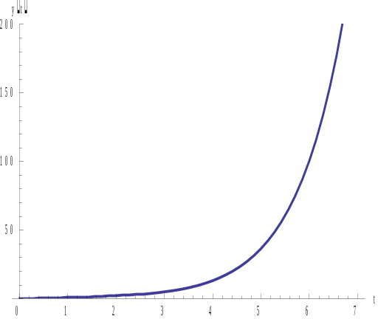
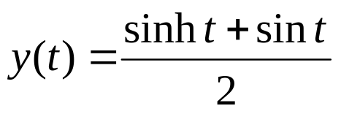
Example 3: Solving a 4th Order IVP (2 of 2)
In the expression:
Setting s = 1 and s = -1 enables us to solve for a and b:
Setting s = 0, b – d = 0, so d = 1/2
Equating the coefficients of in the first expression gives a + c = 0, so c = 0
Thus
Using Table 6.2.1, the solution is

